Slide 1
Which wine is better?
Notes:
Hej, Today I will give a seminar on spectroscopy. We will have a look at different wines. We will try to find out which wine is better solely from spectroscopic methods. Without drinking or tasting it.
For this We will have a very short look into, what we expect to see in wine and than I will introduce the spectroscopic methods which we can use to gain information about the wine.
I will than give you all the measured spectra of 3 different wines and it is your task to decide
1. which spectroscopic method is appropriate to answer which question
2. Analyse and compare the spectra
3. Prepare a short , 1 slide presentation of a short summery of your findings.

Slide 2
Which wine is better?
What determines quality?
And how can we measure this?
Analyze and compare spectra
Prepare a short summary
Notes:
Hej, Today I will give a seminar on spectroscopy. We will have a look at different wines. We will try to find out which wine is better solely from spectroscopic methods. Without drinking or tasting it.
For this We will first need to define, what determines actually the quality of wine? And how can we measure this? For that I will introduce the spectroscopic methods which we can use to gain information about the wine.
I will than give you several measured spectra of 3 different wines and it is your task to decide
1. which spectroscopic method is appropriate to answer which question
2. Analyse and compare the spectra
3. Prepare a short , 1 slide presentation of a short summery of your findings.

Slide 3
1. What determines the quality of wine?

Slide 4
What does wine consist of?
Notes:
Explain what does Glycerol, acids, tannins, phenolics, sugar minerals, sulfides in wine.

Slide 5
What does wine consist of?
Methanol
How sour is the wine?
Colour Aroma
Sweetness
Contamination
from soil/pestizides
Notes:
First we need to have an idea for what we are actually looking at. What is wine? And how is it’s quality determined?
Most of it is clearly water.
Second is alcohol. Which hopefully will be ethanol. Could there be another kind of alcohol in the wine? Methanol. What would be the consequences if there is a lot of methonal in the wine?
Acids, tannins & phenolics, sugar important for the taste of the wine.
Methanol, and contamination, minerals/sulfides have safety/health implications.
Let’s start with the safety of wine. Somehow this is the most basic check of quality. Is it at all drinkable?
- For this it would be nice to quantify the amount of methanol in the wine
- Check whether there are minerals in the wine, which shouldn’t be in there. Any idea what sort of minerals could be in wine?
Quantify the sulfide content in the wine.
The basics of taste are soureness and sweetness. So quantifying the amount of sugar and acids in the wine would be helpful.
Actually I recently saw, that in systembolaget, the amount of sugar is actually quantifyied in the description of the wines.
The actual taste of the wine is a bit more complex, as it depends a lot on the complex mixture of a large variety of different tannins and phenolics.
Explain what does Glycerol, acids, tannins, phenolics, sugar minerals, sulfides in wine.

Slide 6
2. Which spectroscopic methods to use

Slide 7
Interaction possibilities
Ecxitation of vibrations of molecules
Excitation of valence-electrons
Infrared & Raman
Electronic structure of the material
~meV→ Infrared
~eV→ visible / UV
Spin of molecules
Excitation of core-electrons
Energy of atmic orbitals
~meV-ueV→ microwave
~keV→X-ray

Slide 8
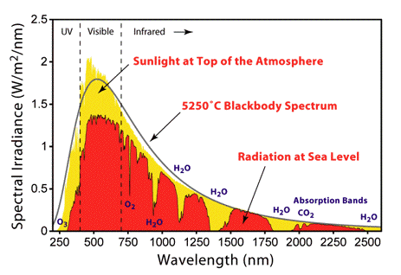
Infrared Spectroscopy
+
Absorption of Infrared light
Leads to vibration or rotation of molecules
Absorption only allowed if:
→hν=ΔE
change in the electric dipole moment induced
-
-
Combination of possible vibrations/rotations gives specific absorption lines which are unique for a specific molecule.
Fingerprinting
Notes:
One can see that water is absorbing Infrared light very well.
One canalso the absorption of o2 and co2. Which is important if looking at the atmosphere.
In general with IR one can detect polar molecules. ? Is this true?

Slide 9
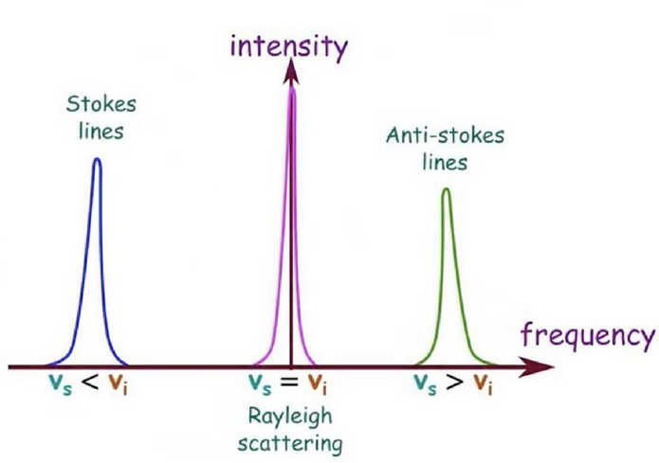
Raman
This is a scattering event. The photon is not absorbed.
’Any’ wavelength can be used.
When light hits a molecule,
the molecule is forced to vibrate
These vibrations absorb part of the
photon’s energy (Stokes shift).
hv-hw
hv
+
-
-
E_{rayleigh}=hv
E_{stokes}=hv-hw
E_{antistokes}=hv+hw
Notes:
Raman scattering is a scattering event. This means, that the photon is not absorbed. To have an effect, there is therefore no need that the energy of the photon matches that of specific energy levels in the molecule.
Whether or not vibrations in the molecule are excited depends on the polarizability of the molecule.
Electric polarizability is the relative tendency of the electron cloud to be distorted from its normal shape.

Slide 10
IR vs. Raman
Absorption of continous IR light by
excitation of vibrations
→ hν=ΔE
vibrations must induce a change in
the net dipole moment
polar solvents
water
Excitation of vibrations by portion of the photon’s energy (NIR/Vis/UV)
→ hν^{fin} = hν^{ini} +/- ΔE
vibrations must change the polarisability of the molecule (often bond-length)
→ non-polar molecules

Slide 11
Interaction possibilities
Ecxitation of vibrations of molecules
Excitation of valence-electrons
Infrared & Raman
Electronic structure of the material
~meV→ Infrared
~eV→ visible / UV
Spin of molecules
Excitation of core-electrons
Energy of atmic orbitals
~meV-ueV→ microwave
~keV→X-ray

Slide 12
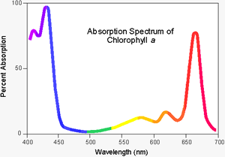
UV-Vis
Absorption of continous light in the UV to visible range
excitation of valence electrons
→ hν>ΔE
Electronic structure of a material
- Important for electronic devices
Notes:
Water is more Raman active and less IR active. Polar solvents

Slide 13
Interaction possibilities
Ecxitation of vibrations of molecules
Excitation of valence-electrons
Infrared & Raman
Electronic structure of the material
~meV→ Infrared
~eV→ visible / UV
Spin of molecules
Excitation of core-electrons
Energy of atmic orbitals
~meV-ueV→ microwave
~keV→X-ray

Slide 14
Interaction possibilities
Ecxitation of vibrations of molecules
Excitation of valence-electrons
Infrared & Raman
Electronic structure of the material
~meV→ Infrared
~eV→ visible / UV
Spin of molecules
Excitation of core-electrons
Energy of atmic orbitals
~meV-ueV→ microwave
~keV→X-ray

Slide 15
XRF
K = 1S
L= 2S 2P
M= 3S 3P 3D
K
L
M
Notes:
X-ray fluorescence. May be quite far from what you have previously encountered. But fortunately XRF is a pretty straight forward method, which is one of the easier methods to analyse.
What is happening in XRF.
Add that you alsways see Kalpha and Kbeta. In welchem Bereich liegen Kalpha und Kbeta? Wie sind die Intensitätsverhältnisse zwischen Kalpha und Kbeta. In welchem Bereich liegen die L linien?

Slide 16
XRF/XES
K = 1S
L= 2S 2P
M= 3S 3P 3D
Ejected electron
Incident X-ray
K
L
M
Notes:
X-ray fluorescence. May be quite far from what you have previously encountered. But fortunately XRF is a pretty straight forward method, which is one of the easier methods to analyse.
What is happening in XRF.
Add that you alsways see Kalpha and Kbeta. In welchem Bereich liegen Kalpha und Kbeta? Wie sind die Intensitätsverhältnisse zwischen Kalpha und Kbeta. In welchem Bereich liegen die L linien?

Slide 17
XRF
K = 1S
L= 2S 2P
M= 3S 3P 3D
Ejected electron
Incident X-ray
K
L
M
Notes:
X-ray fluorescence. May be quite far from what you have previously encountered. But fortunately XRF is a pretty straight forward method, which is one of the easier methods to analyse.
What is happening in XRF.
Add that you alsways see Kalpha and Kbeta. In welchem Bereich liegen Kalpha und Kbeta? Wie sind die Intensitätsverhältnisse zwischen Kalpha und Kbeta. In welchem Bereich liegen die L linien?

Slide 18
XRF
K = 1S
L= 2S 2P
M= 3S 3P 3D
Ejected electron
Kα X-ray emitted
K
L
M
Notes:
X-ray fluorescence. May be quite far from what you have previously encountered. But fortunately XRF is a pretty straight forward method, which is one of the easier methods to analyse.
What is happening in XRF.
Add that you alsways see Kalpha and Kbeta. In welchem Bereich liegen Kalpha und Kbeta? Wie sind die Intensitätsverhältnisse zwischen Kalpha und Kbeta. In welchem Bereich liegen die L linien?

Slide 19
XRF
K = 1S
L= 2S 2P
M= 3S 3P 3D
Ejected electron
Kβ X-ray emitted
K
L
M
Notes:
X-ray fluorescence. May be quite far from what you have previously encountered. But fortunately XRF is a pretty straight forward method, which is one of the easier methods to analyse.
What is happening in XRF.
Add that you alsways see Kalpha and Kbeta. In welchem Bereich liegen Kalpha und Kbeta? Wie sind die Intensitätsverhältnisse zwischen Kalpha und Kbeta. In welchem Bereich liegen die L linien?

Slide 20
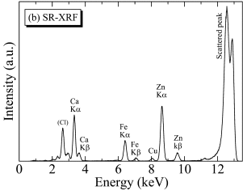
XRF/XES
K = 1S
L= 2S 2P
M= 3S 3P 3D
Ejected electron
Kβ X-ray emitted
Incident X-ray
Kα X-ray emitted
K
L
M
Motohiro et al. https://doi.org/10.1016/j.jdsr.2014.07.001
Notes:
X-ray fluorescence. May be quite far from what you have previously encountered. But fortunately XRF is a pretty straight forward method, which is one of the easier methods to analyse.
What is happening in XRF.
Add that you alsways see Kalpha and Kbeta. In welchem Bereich liegen Kalpha und Kbeta? Wie sind die Intensitätsverhältnisse zwischen Kalpha und Kbeta. In welchem Bereich liegen die L linien?

Slide 21
Interaction possibilities
Ecxitation of vibrations of molecules
Excitation of valence-electrons
Infrared & Raman
Electronic structure of the material
~meV→ Infrared
~eV→ visible / UV
Spin of molecules
Excitation of core-electrons
Energy of atmic orbitals
~meV-ueV→ microwave
~keV→X-ray

Slide 22
3. Analyze the spectra 4. Make a report about the wine

Slide 23
Which wine is better?
B
A
Spectroscopic methods: XRF, IR absorption, Raman, UV-Vis absoption, NMR

Slide 24
Asses and compare the quality of wine A and B: Is the wine contaminated? Is there methanol in the wine? Or heavy metal traces? Is it safe to drink? What determines the colour of wine? And what can the colour tell us? Which wine is more sour?
Spectroscopic methods: XRF, IR absorption, Raman, UV-Vis absoption, NMR
Notes:
Methanol wine ’simulieren’, XRF from mineral water, create nmr spectra with more / less sugar, more/less acids?
Discuss which measurements techniques should be used to answer the question?

Slide 25
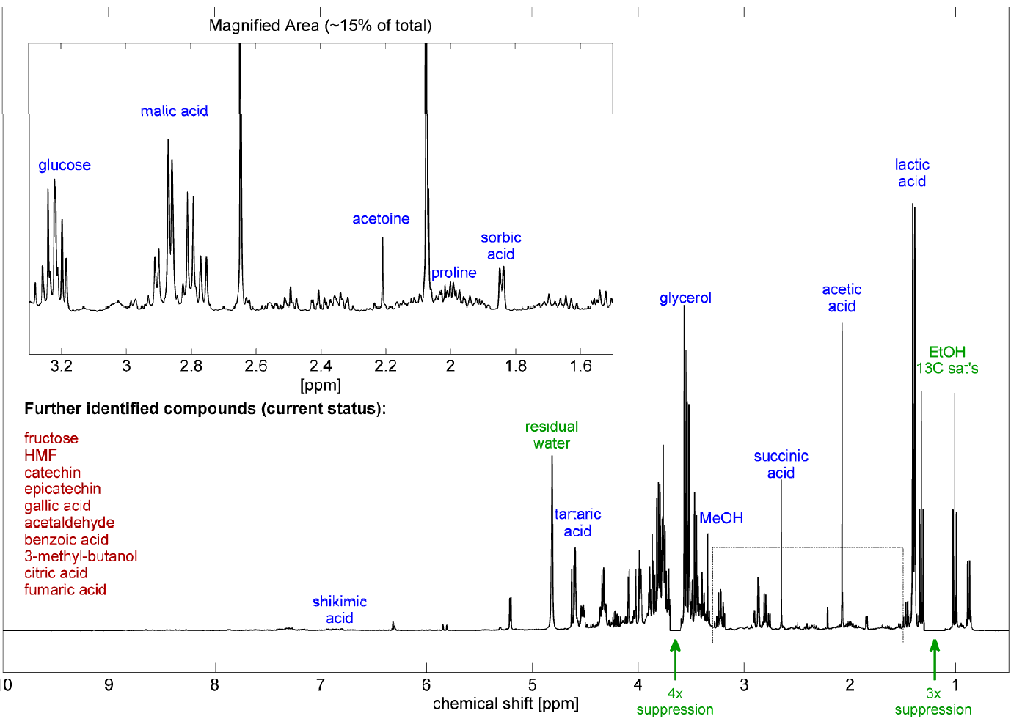

Slide 26
